Slide 1
Introduction and Ch. 1
ARE/ECN 115A

Slide 2


Slide 3



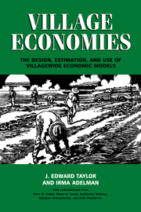


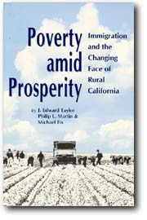
What I Do
(Besides cause trouble)
High-level Impact Evaluation
Poverty and Inequality
Migration, human capital and development
Environment-development interactions (CGD, resource extraction)
Gender
REAP/PRECESAM/ENHRUM
Editor, Am J Ag Econ

Slide 4
What Is Poor?

Slide 5
A Social Cash Transfer Program
Main Goal:
“Improve the living standards of Orphans and Vulnerable Children (OVC)”
UNICEF with country government
One of seven programs like it in Sub-Saharan Africa

Slide 6
Transfer Scheme
Unconditional social cash transfer (SCT)
  Targeted to poor and vulnerable households
Asset poor, labor poor, often elderly and infirm, many child-headed households
About US$50 per quarter
Represents about 30% of income for the treated households

Slide 7
Social Protection vs. Production?
Should countries spend scarce resources on SCTs?
…or should they spend them on productive programs?
  New crop technologies, input subsidies, crop price supports, extension
The big question UNICEF and African governments face

Slide 8
Q: What Happens When A Transfer Hits the Target Household?
A: It Spends It
Expenditure shares on: | A | B | C | D
Crop | 22% | 27% | 12% | 15%
Livestock | 25% | 16% | 30% | 21%
Retail | 32% | 37% | 27% | 33%
Services | 4% | 4% | 4% | 6%
Production | 2% | 2% | 2% | 1%
ROW | 15% | 15% | 25% | 24%

Slide 9
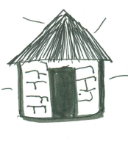
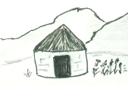
Transfer
Treatment
Control

Slide 10

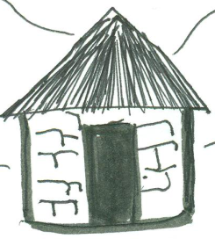


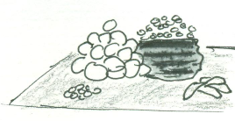
Transfer
Treatment
α_{T,NT}
α_{T, T}
Control

Slide 11
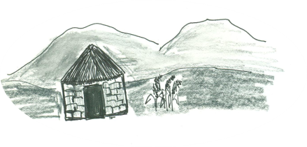
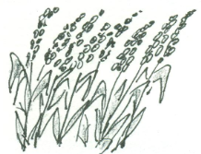






Transfer
Treatment
α_{T,NT}
α_{T, T}
α_{NT,NT’}
Control
Rest of Lesotho
Rest of World

Slide 12
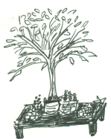
Transfer
Treatment
α_{T,NT}
α_{NT,T}
α_{T, T}
α_{NT,NT’}
α_{NT’,NT}
Control
Rest of Lesotho
Rest of World

Slide 13









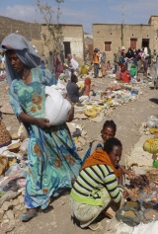
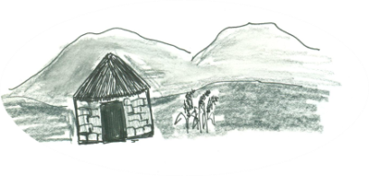
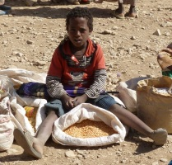
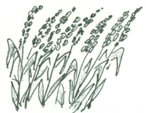
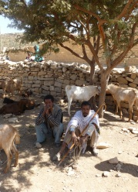
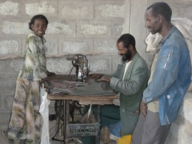
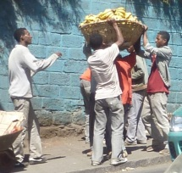



Transfer
Treatment
α_{T,NT}
α_{NT,T}
α_{T, T}
α_{NT,NT’}
α_{NT’,NT}
α_{NT,C}
Control?
Rest of Lesotho
Rest of World

Slide 14
Effect on Total Income
 | Multiplier | Level Change
Total Income Y
Nominal | 2.23 | 7.38
(CI) | ( 2.08- 2.44) | (6.89 -8.06 )
Real | 1.36 | 4.5
(CI) | ( 1.25- 1.45) | (4.15 -4.80 )

Slide 15
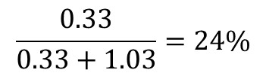
Effect on Household Incomes
Household A Income | Multiplier
nominal | 1.15
cpi increase in % | 1.96%
real | 1.03
Household C income
nominal | 1.08
cpi increase in % | 1.88%
real | 0.33
Ineligible Households
$$\frac{0.33}{0.33+1.03}=24\%$$

Slide 16
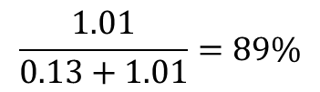
Effects on Production
Production multiplier for: | HH A (24% pop) | HH C (76% pop)
Crop | 0.03 | 0.15
Livestock | 0.02 | 0.26
Retail | 0.07 | 0.52
Services | 0 | 0.08
Other Production | 0 | 0
TOTAL | 0.13 | 1.01
$$\frac{1.01}{0.13+1.01}=89\%$$

Slide 17
How to Do Studies Like This?
1. Compelling research problem
2. Good theory
3. Careful review of what others have done
4. Clear, testable hypotheses
  Here, that transfers create significant spillovers
5. Good Data
6. Convincing empirical approach

Slide 18
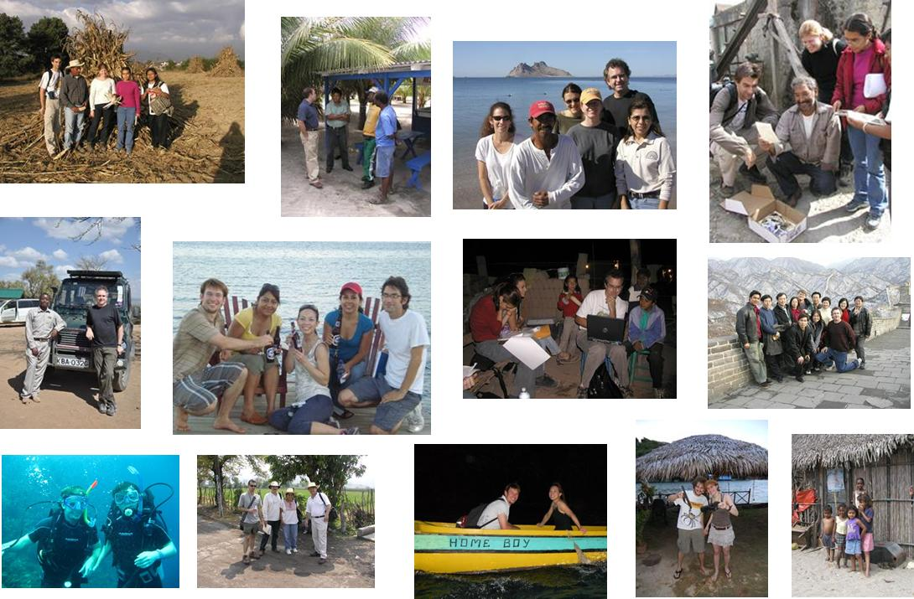
From Theory to the Field

Slide 19

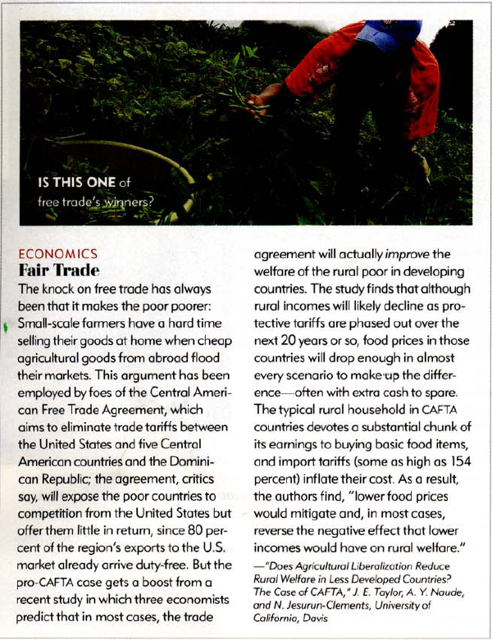
Making a Difference (We Hope)

Slide 20
ARE 115A
Economics of Development
Our course websites: rebeltext.org and smartsite
E-mail Coordinates:
J. Edward Taylor jetaylor@ucdavis.edu
Kjersti Nes nes@primal.ucdavis.edu
Michael Norton norton@primal.ucdavis.edu
Anil Bhargava bhargava@primal.ucdavis.edu
Ted Gilliland gilliland@primal.ucdavis.edu
Sunghun Lim slim@primal.ucdavis.edu

Slide 21
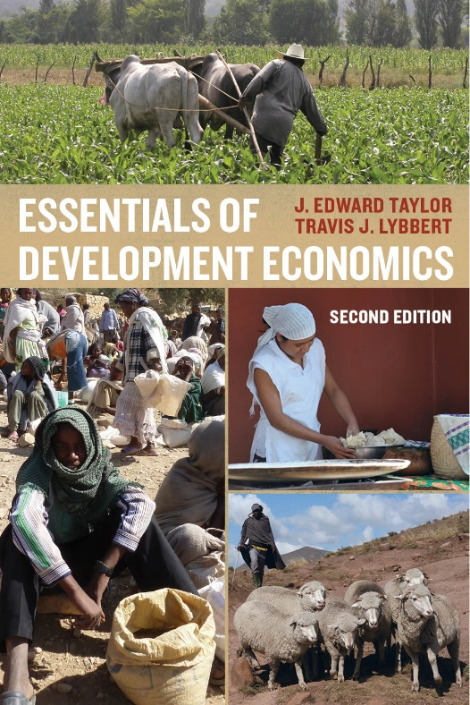
Book (The Core of this Course)
Efficient and Compact, Economical, Portal to the Internet
Additional required readings will be posted on the course websites each week:
Rebeltext.org (public domain)
Smartsite (specific to our class)

Slide 22
Grading

Slide 23
What Is Development Economics?
Everything: Just pick up a traditional textbook (or look in RebelText)
So why have a field of development economics?
  There must be something different about poor countries. What is it?
Book: How our thinking about development has evolved

Slide 24
Evolution of Development Thought
Growth
Inequality and Poverty
Trusting Markets
Not Trusting Markets
The Experimental Revolution
Overview in Chapter 1; we’ll cover all of these in this class

Slide 25
Back to the Bigger Question: What’s Development?
Economic development entails far-reaching changes in the structure of economies, technologies, societies, and political systems.
Development economics is the study of economies that do not fit many of the basic assumptions underpinning economic analysis in high-income countries
  Including well-functioning markets, perfect information, and low transaction costs.
When these assumptions break down, so do the most basic welfare and policy conclusions of economics
  And we need new tools.

Slide 26
Efficiency Versus Equity
Rich countries: seen as separate
  Grow the pie, then figure out how it gets divvied up
In Poor countries: Equity and efficiency cannot usually be separated

Slide 27
Why Efficiency Cannot Be Separated from Equity
Banks are unwilling to loan money to small farmers
Poor people cannot get insurance to protect themselves against crop loss or sickness
Poverty and malnutrition prevent kids from growing up to become productive adults
Access to markets for the stuff people produce, the inputs they use, and the goods they demand is different for the poor and rich
The ability to get a job depends on who you are, not on how productive you are
No more student loans?

Slide 28
How Do We Know When a Country is Developing?
Is it growth?

Slide 29
But Careful: Costa Rica vs. Equatorial Guinea
Infant Mortaity

Slide 30
Income and Growth
In rich countries: development and growth are seen as similar
  E.g., think about urban development projects
A lot of things correlate with income
  Life expectancy is higher in the US than Malawi
But most development economists would say development is different from growth
  …though it’s hard to have development without growth

Slide 31
What Development Projects Focus On
Concrete outcomes related to poverty, malnutrition, inequality, and health
Basic physical needs like nutrition, shelter, and clothing
Development of the mind (and of course people’s earnings potential), through education
The environment, conservation, and sustainable resource use
Human rights, gender and ethnic equity
Government corruption
Creation of infrastructure: transport, communications, market

Slide 32
So What Is Development Then?
What Does the UN Say?
(The Millennium Development Goals) http://www.youtube.com/watch?v=vddX4n30sXY
(QR Code in RebelText)

Slide 33
Millennium Development Goals
Set of targets adopted by 189 nations in Sept. 2000 (specific targets for each; p. 51)
  1. Eradicate extreme poverty and hunger
  2. Universal primary education
  3. Ender equity, empowerment of women
  4. Reduce child mortality
  5. Improve maternal health
  6. Combat HIV/AIDS, malaria, other diseases
  7. Environmental sustainability
  8. Develop a global partnership for development
Some on track, others not (esp. child mortality, gender equity in school enrollment)
Effects of recent crisis worrisome (Example from Mexico)
Per-capita income growth “increases the range of human choice” (W. Arthur Lewis, 1995, The Theory of Economic Growth)

Slide 34
What Happens When Countries Develop?
Social indicators improve (Chapters 3-5)
  Health: Life expectancy, infant mortality
  Education: Literacy, higher education
Structure of economy changes (Chapter 8)
  Shift from agriculture to higher-paying urban jobs
  Expansion of markets
    Spatial
    Varieties: inputs, outputs, credit, insurance, futures
Institutions develop and deepen (Chapters 9-10)
  Legal, market, government, etc.
    Ex: Contracts and Real Estate
Accelerating then decelerating population growth (the population transition)
  Emigration to immigration (the migration transition)
Application of science to problems of production

